Slide 1
Lecture 6a: Model and Code Analysis
Gregory Gay
TDA594 - November 19, 2020

Slide 2
Where We Stand
Feature Models can be expressed using propositional logic formulae (φ).
Based on model and cross-tree constaints.
Valid feature selections result in (φ = true).
SAT Solvers can identify valid configurations.
If none can be found, the model is inconsistent.
Enables many different model analyses.

Slide 3
Today’s Goals
Feature-to-Code Mappings
Domain Implementation (Analysis of Code)

Slide 4
Feature-to-Code Mappings
Notes:
Just start with a question - want you to start thinking about this. (read)
This isn’t something with one answer, or even a right answer. It’s something we’ll keep returning to

Slide 5
Feature-To-Code Mappings
Feature models describe the problem space.
Models are implemented in source code.
Similar analyses can examine mapping of feature models to code.
Which code assets are never used?
Which code assets are always used?
Which features have no influence on product portfolio?
Notes:
In the last section, we focused on the problem space with feature models and feature selections. Now, we investigate the mapping from features to code, that is, the mapping from problem space to solution space. By leveraging the same analyses of the previous section, we can look at how to detect unused modules, dead code in preprocessor-based implementations, and elaborate on issues regarding build systems that can complicate analyses. Specifically, we explore Which code fragments are never included in any product? • Which code fragments are included in all products? • Which features have no influence on the product portfolio?

Slide 6
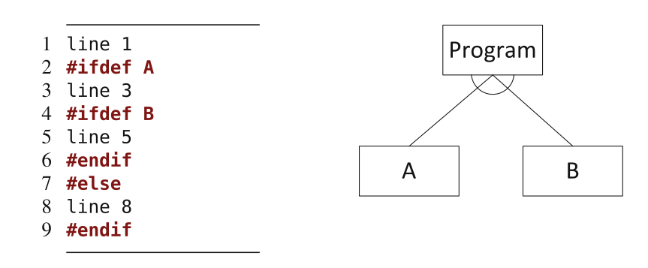
Dead Code
Features that can never be incorporated.
Feature B, in the code, required Feature A to also be selected.
Model states that A and B are mutually exclusive.
Notes:
Our first goal is to find dead code—fragments that are never included in any valid feature selection. Dead code can be an indicator for an incorrect mapping or an over-constrained feature model. If we look at the model and corresponding code on the slide here: Line 5 is included only if the features A and B are both selected, but the feature model specifies both features as mutually exclusive. That is, Line 5 can be never included in any product of the product line. Developers were likely unaware that features A and B are defined as mutually exclusive, or the feature model was too strict and both features could actually be optional. We have a bug in our model or in our code, and this needs to be resolved, as B cannot actually be used right now without requiring A too. More likley, the model is at fault.

Slide 7
Presence Conditions
Describes the set of products containing a code fragment.
pc(c) = (conditions for c to be included in a product)
pc(line 3) = A
pc(line 5) = A ∧ B
pc(line 8) = ¬ A
pc(lines 3-5) = A ∧ B
pc(lines 3-8) = A ∧ B ∧ ¬A
(cannot be included in any product)
Notes:
To identify dead code, we need to reason about the mapping from features to code. Formally, we describe the mapping as a function from code fragments (from the set C of all code fragments) to sets of products represented by feature selections. That is, we map each code fragment to the set of products in which it is included. As a compact representation of large sets of feature selections and corresponding products, we use what is called a presence condition—a propositional formula representing a set of feature selections. This is in line with the propositional formula representing the set of valid feature selections in a feature model. A presence condition is a Boolean expression defining the feature selections in which a particular code fragment is present. We use function pc(c) to denote the presence condition of a code fragment c in the form of a propositional formula. For example, here the code fragment in Line 3 has the presence condition A and is included in all products with feature A ; Line 3 has the presence condition A ∧ B and is included in all products with the features A and B ; and Line 8 has presence condition ¬ A and is included in all products that do not include feature A. We can do this for any arbitrary code selection, so the presence condition for lines 3-5 would be the factors that must be met for all three lines to be included, or A ^ B again. What about 3-8? Well, again, the factors are then A ^ B ^ !A, which is impossible to meet, so the complete fragment 3-8 can’t be included in any product, but we can look at subsets of that that can.

Slide 8
Dead Code
C pc()
Fragment is dead if never included in any product.
φ represents all valid products.
Fragment C is dead iff (φ ∧ pc(C)) is not satisfiable.
True
A
A ∧ B
¬A
φ = Program ∧ (A ∨ B) ∧ ¬(A ∧ B)
(φ ∧ pc(line 5)) is not satisfiable:
Program ∧ (A ∨ B) ∧ ¬(A ∧ B) ∧ (A ∧ B)
Notes:
A code fragment is dead if it is never included in any product of a product line. Since the representation of the feature model as propositional formula φ represents all valid feature selections (products), a code fragment c is dead iff the conjunction of presence condition and feature model is not satisfiable: ¬ SAT (φ ∧ pc(c)) . That is, there is no feature selection that is both valid according to a feature model and that fulfills the presence condition. In our example, we have the presence conditions , A , A ∧ B , and ¬ A for the Lines 1, 3, 5, and 8 respectively. The predicate of the feature model is φ = Program ∧ ( A ∨ B ) ∧ ¬( A ∧ B ). Line 5 is dead because φ ∧ A ∧ B is unsatisfiable.

Slide 9
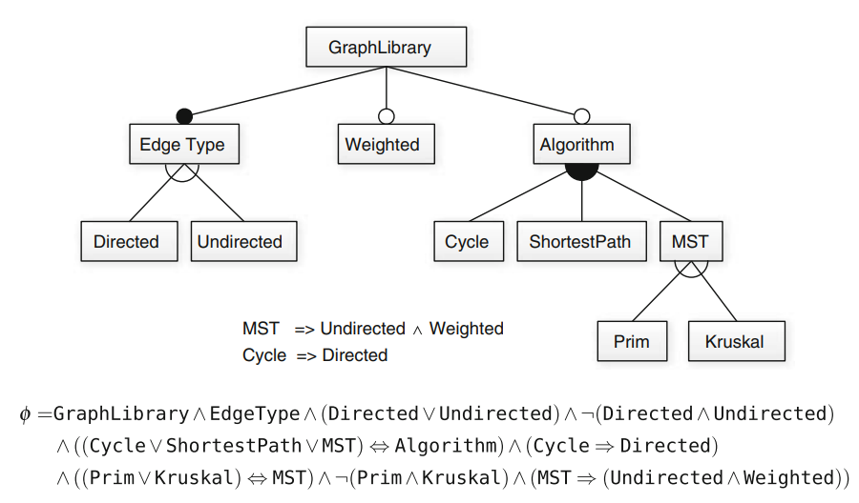
Mandatory Code
Fragment is mandatory if always included in a product.
φ represents all valid products.
Fragment C is mandatory iff (φ ∧ ¬pc(C)) is not satisfiable.
If code implemented correctly, the fragment for EdgeType will be mandatory.
Notes:
In a similar manner, we can detect code fragments that are included in all products.
Such code fragments are mandatory. A code fragment c is mandatory iff φ ⇒
pc(c) , that is, (φ ∧ ¬ pc(c)) is not satisfiable. There is always a configuration that includes that code. In our previous example, there were no such cases. However, if we go back to the graph library, we see that the Edge Type feature is mandatory in the model. If our code matches the model, the presence conditions for EdgeType will ensure that the corresponding code fragment is mandatory as well.

Slide 10
Domain Implementation
Notes:
Just start with a question - want you to start thinking about this. (read)
This isn’t something with one answer, or even a right answer. It’s something we’ll keep returning to

Slide 11
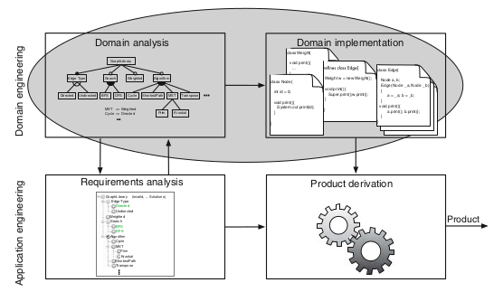
Analysis of Product Line Code
Focus on analyzing variability in program structures
Variability-aware Analyses
Traditional analyses (i.e., type checking) extended from one product to entire line.
Goal of analyzing whole line in one pass instead of all individual products.
Notes:
After analyzing feature models and the mapping from features to code, we now focus on analyzing variability in code itself, in program structures, such as function calls or statements. We call these analyses variability-aware analyses, because they perform traditional analyses, such as type checking and model checking, but they incorporate knowledge about variability in the system. Again, we want to analyze and ensure properties for all possible products of a product line. These analyses build on top of the analyses we have presented earlier, and reason about all kinds of domain-engineering artifacts (feature models, domain implementations, and the mapping). The idea of variability-aware analysis is not to invent new kinds of analysis techniques, but to lift existing analysis techniques developed for individual programs to entire product lines (that is, to domain artifacts). Some examples of established analyses that we want to lift include type checking, model checking, data-flow analysis, and deductive verification. The goal is to perform the same analysis on a product line that we could perform on every possible product separately. Ideally, variability-aware analysis should yield the same results, but in a more efficient way. While a brute force analysis would check each individual concrete product, we want to capture the important information about what varies and analyze that instead. variability-aware analysis should yield the same result as applying an existing analysis in a brute-force approach. At the same time, we expect that variability-aware analysis is typically much faster, because it can exploit similarities and reuse analysis results across products. For example, if multiple products share code (from the base code or from some feature code), variability-aware analysis
might only need to analyze it once and not over and over again for each possible
feature selection. This is not always possible, but is more frequently than you might think.

Slide 12
Example: Type Checking
Verifying and enforcing constraints of data types.
Is String being used as Integer?
If we call a method, does it return the right type of data?
Can be checked during compilation or at runtime.
Same analyses can be applied to other properties.
Part1 = 10
Part2 = “Wobuffet”
Sum = Part1 + Part2
String getName() { return “Wobuffet”; }
Part1 = 10
Sum = Part1 + getName()
Notes:
We illustrate variability-aware analysis with type checking, because it is well-understood and comparably easy to explain. However, the same ideas I am presenting will work for other analyses of properties of interest as well. Type checking is the process of verifying and enforcing the constraints of data types. If a variable is used as an integer, is it in the proper format to be used in that manner? (3) It can occur either at compile time (i.e. statically) or at runtime (i.e. dynamically). Type checking is all about ensuring that the program is type-safe, meaning that the possibility of type errors is kept to a minimum.

Slide 13
Terminology
Check properties about program or feature model.
Type Checking: Does the program have type errors?
We assume a property must hold over all products.
Complete variability-aware analyses give same results as brute-force analysis.
Sound analyses ensure all violations in domain artifacts hold in concrete products.
Notes:
There is a large design space of different analyses and researchers and developers have explored many different strategies to analyze programs. Before I discuss specific analyses, I want to introduce some terminology that helps to distinguish different variability-aware analyses within the design space. First, different kinds of analysis check different properties and give different guarantees. For example, a type system checks well-typedness of programs to ensure the absence of a certain class of errors, whereas model checking - what we did with the SAT solvers - verifies that the behavior of a model satisfies a given specification, certain properties of interest. Second, in a product-line context, the issue arises of how to specify the expected behavior of a product line. Can we specify the behavior of each feature in isolation, should we provide a specification per product, or is a single global specification for all products sufficient? For simplicity, here we always expect a global specification that must hold for all products, such as ‘all products shall be well-typed’ or ‘there shall be no null-pointer exceptionsduring the execution of any product.’ Finally, there are different strategies to lift analyses to handle the large configuration space of a product line. We say a variability-aware analysis is complete, if it finds the same property violations that the brute-force approach would find. We say a variability-aware analysis is sound, if every property violation found in domain artifacts is also a property violation in a corresponding concrete product featuring the affected domain artifacts.

Slide 14
Sampling Strategies
Instead of brute-force, try a subset of products.
Selection criteria:
Feature Coverage: All features covered at least once.
Feature-Code Coverage: All code fragments included at least once.
Pairwise Feature Coverage: All pairs of features covered at least once.
N-wise Coverage: All N-way (3-way, 4-way,...) combinations.
Notes:
A brute force approach, where we check all possible concrete products for violations, is not generally possible. There are too many possibilities. A first strategy, which is easy to apply, is to check only a (suitable) subset of all products of a product line with a normal single-product analysis. For example, we can choose interesting feature selections, derive the corresponding products, and simply compile those or use runtime detection mechanisms to find type errors in the sampled products. We don’t check everything, but try to cover a reasonable subset of products. The main question here is how to select the sample of feature selections to analyze? Typically, we want to check only a small number of products, but achieve a high coverage according to some criterion. Among many others, possible coverage criteria in product lines are:
• Feature coverage: Select products such that every feature (from the problem space) is included in at least one product. • Feature-code coverage: Select products such that every code fragment (from the solution space) is included in at least one product. • Pair-wise feature coverage: Select products such that each pair of features is included in at least one product. Additionally, we can demand that for each feature pair ( f , g ) there is a product with f but without g and a product with g but without f , in addition to a product with both f and g . • N-wise feature coverage: Much like pair-wise feature coverage, but all possible n -tuples of features should be included in at least one product. All 3-way, 4-way, etc combinations up to a limit of how many we want to include.

Slide 15
Sampling Strategies
Strategies:
Popular Features: Focus on what customers use
Domain-Specific: Base coverage on factors important to product domain.
Balance between # of analyses and error detection.
Sampling is sound, but not complete.
Detected errors hold in products, but not all products tested.
Notes:
Two more: • Popular products and features: Select products frequently used by customers or products with features that are often requested. • Domain-specific: In many domains experts can provide suitable coverage criteria for the domain, for example, critical features such as transaction management in a database system.Sampling with feature coverage alone may result in a poor detection error rate, because problems related to interactions between multiple features might not be detected. Pair-wise coverage attempts to address this problem by analyzing every pair of features, so that we can detect all interactions between two features. To achieve pair-wise coverage, only a moderate number of products are necessary: For example, a feature model with 88 features that can be covered by 40 products and a feature model with 287 features that can be covered with 62 products. Pairwise coverage is generally the basis of testing of product lines, because we can’t try every option, and this attains a nice balance betwee detection of feature interaction problems and number of test cases or - in this case- analyses. Also, n -wise coverage with larger n is possible; we may detect
more interactions, but this approach requires much larger samples. When selecting a sample, we always have to face a trade-off between the number of products selected (analysis effort) and the desired coverage.Note that sampling strategies are sound but always incomplete. Since we do not look at all products, we might miss errors. We cannot establish guarantees for an entire product line. However, when we find an error, we are sure that it actually is an error.

Slide 16
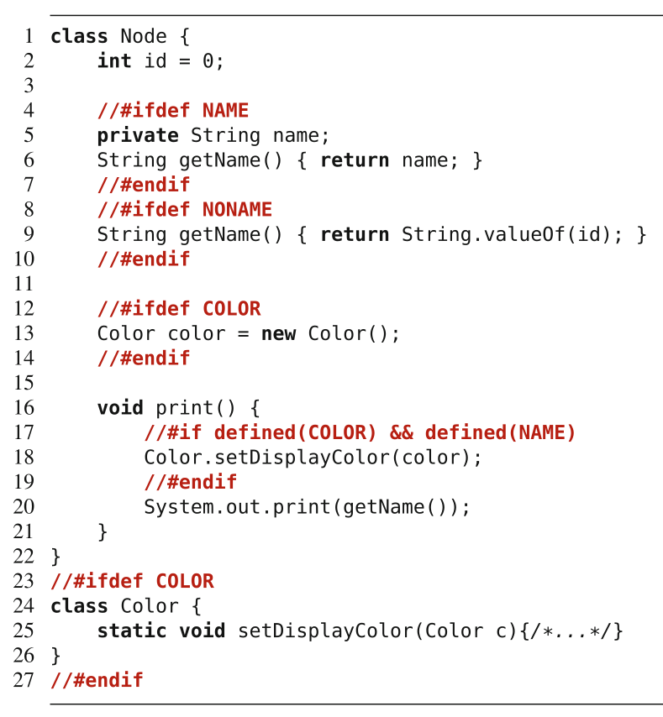
Family-Based Type Checking
Compiler uses #ifdef annotation to decide what code to include in binary.
Graph product line, Node class.
Features: NAME, NONAME, COLOR.
Selecting neither or both NAME/NONAME leads to error.
Notes:
Next, let’s look at an example of how to analyze entire product lines: family-based type checking. We will look at this in the context of preprocessor-based product line implementation. This is something we’ve highlighted a few times, but as a reminder, this is when you include special annotations recognized by the compiler - like IFDEF in C/C++. The compiler will read those when parsing the code, and only include the correct code fragments in the compiled binary, based on the selected features. To illustrate family-based, variability-aware type checking, we have a class from a Graph library representing a node. Now, Nodes can optionally have a name, in addition to their id (for example, to store a person’s name if nodes represent people). Feature Name introduces a new method getName , and, to provide the same interface without names, feature NoName provides the same method, but with a default implementation. Together with the feature Color , our example has three features, which can be combined to eight different products. For some of these products, a Java compiler will issue type errors: Selecting neither Name nor NoName leads to a dangling method invocation in the parameter of the print statement (Line 20; getWeight has not been declared); selecting both Name and NoName leads to a method declared twice. To detect these kinds of errors with a brute-force approach, we have to derive and compile all eight products individually. A brute-force approach is fine for this example, but it clearly does not scale for product lines with more features, as the number of products to check grows exponentially. Instead, we can use Java’s type system to take variability into account.

Slide 17
Presence Conditions on Structures
Can identify presence conditions for classes, methods, fields, variables.
pc(getName() [line 6]) = NAME
pc(getName() [line 9]) = NONAME
pc(Color.setDisplayColor(color) [line 18]) = COLOR ∧ NAME
pc(System.out.print(getName()) [line 20]) = TRUE ⇒ (NAME ∨ NONAME)
Calls getName(), requires at least one to exist.
Notes:
Variability-aware type analysis reasons about presence conditions in the source code. However, in contrast to the presence conditions for arbitrary text ragments like we used before, we are now going to reason about presence conditions for structural program elements in the domain implementation, such as variables, fields, and methods. In our example, the two methods getWeight have the presence condition Name (Line 6) and NoName (Line 9), respectively; the first statement in the print function has presence condition Color ∧ Name (Line 18). What about line 20? it isn’t in an IFDEF, right, so does it have no presence conditions? Well… That’s where this can get complicated. It calls getName. We have two possibilities for GETNAME. That leads to a condition that one of those needs to be set.

Slide 18
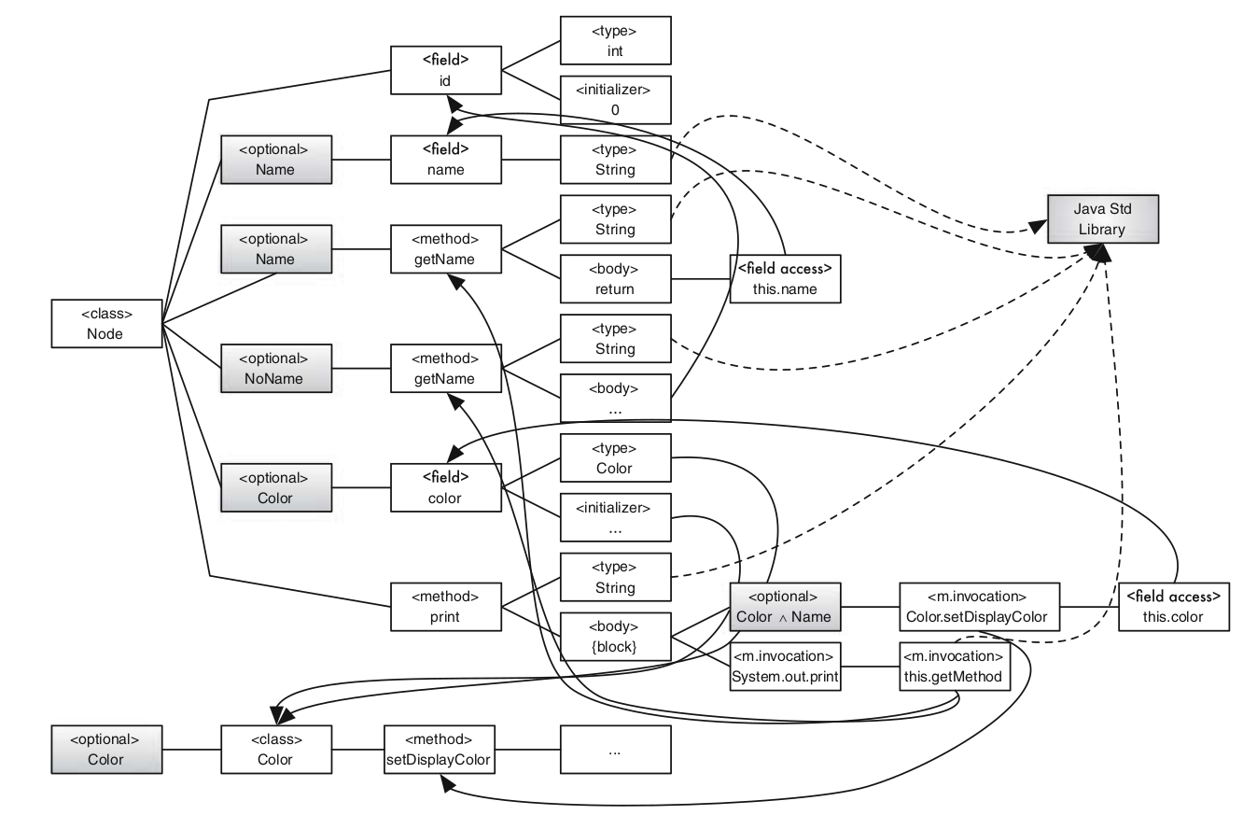
Presence Conditions on Structures
Notes:
We can emphasize the mapping of presence condition to program elements by showing an abstract-syntax tree of the code fragment that includes nodes for variability < optional > nodes denote optional subtrees with a presence condition. This shows the program flow between various elements. (point out some) (id is of type int, it is initialized to 0) (if Name is set, we declare field name of type string, we declare method getName of return type String and its body is a return with access of field name, connecting back to the field declaration) (method print, has a body, optional printing of color - if constraints color and name set - invokes color.setDisplayColor, accessing field this.color. Then, invokes system.out.print of the name, calling one of the two name methods, depending on the options set.

Slide 19
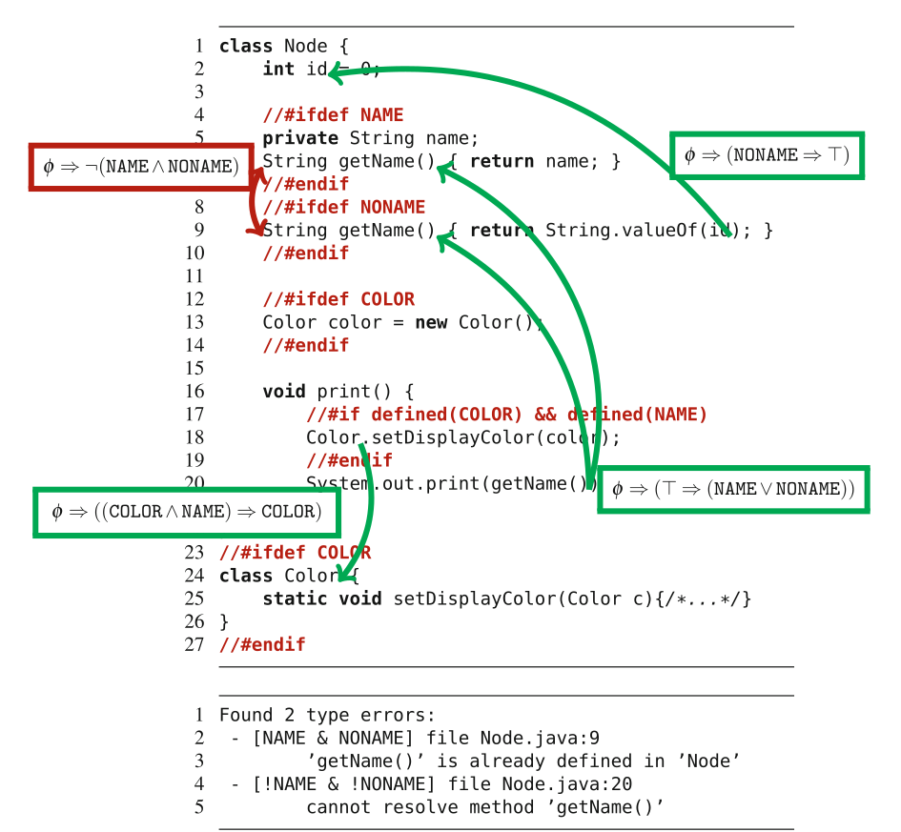
Reachability
Examine lines reachable from each line to identify presence conditions.
If NAME ∧ NONAME, error on line 9.
If ¬NAME ∧ ¬NONAME, error on line 20.
Notes:
A family-based analysis operates on a program representation that is variable. In our example, family-based type checking takes place on a variable abstract syntax tree that represents the whole space of possible products. Let us generalize from an example: When resolving a method invocation, there can be different target declarations in different products. The type system must ensure that all derivable products that contain the method invocation must also contain a corresponding method declaration as target (with an expected type). In our example, method getName is invoked in all products with presence condition true (that print statement on Line 20 is always included, and that statement is expected to return type String, but a corresponding method declaration is only present in products with the features Name or NoName (Lines 6 and 9, both returning type String ). Just by comparing presence conditions within the product-line implementation, we can identify that products without feature Name and without feature NoName will contain a type error. If such feature selections are valid according to the feature model - if the feature model says we can have a product with neither NAME or NONAME, our analysis of the code can issue an error message: “cannot resolve method getName() in Line 20 if ¬ Name ∧ ¬ NoName ”, as shown here. Similarly, if our model says that we can have both NAME and NONAME defined, we have an issue when we hit line 9, as we already have a method with that signature declared in line 6, so we can issue an error message of “getName is already declared” for the product where NAME and NONAME are selected.

Slide 20
Reachability Conditions
When a call is made from source to target, a valid target must exist.
φ ⇒ (pc(s) ⇒ ∨_{t∊T} pc(t))
If negation of this constraint can be satisfied, there are feature selections that will not compile.
SAT solver can identify selections where there are no valid targets for a call from a source.
Notes:
A type system performs many other lookups, of fields, local variables, methods, classes, types, and so on. In all cases, we need to ensure that a target element is present whenever the source element is present for a call (and often with additional constraints on types). For instance, a field can only have type Color and we can only instantiate class Color when a corresponding class declaration is present - when Color is actually declared. More generally, given a feature model φ, presence conditions pc , a source element s , and a set of target elements T , we can formulate the following generic constraint, which we call the reachability condition: (2). When the feature model is satisfied, that implies that if the presence conditions on the source are met, then the presence conditions for some valid target must be met (this is an OR over all targets). If that constraint is not a tautology (that is, if its negation is satisfiable by a SAT solver), we report an error message, indicating that there are products in the product line that do not compile because there is not a valid target to call. Once again, we use a SAT solver to perform this analysis. We can even pinpoint the error message to a set of feature selections by negating the constraint. It will identify feature selections that do not compile.

Slide 21
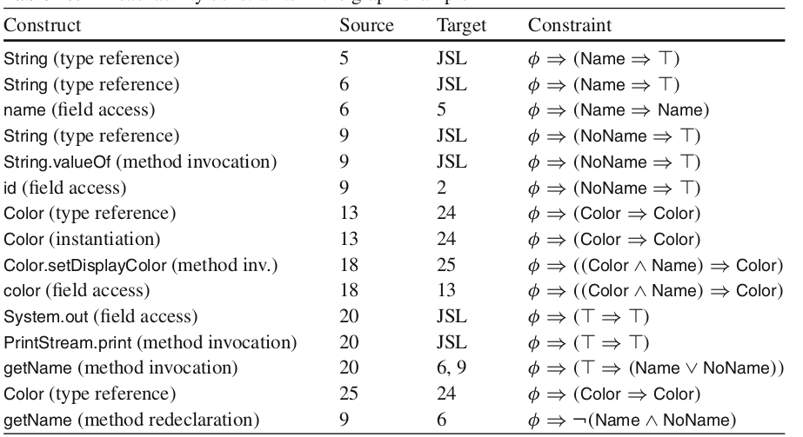
Reachability
JSL = Java Standard Library
Notes:
Here are the complete set of reachability constraints for this example. If we can satisfy the negation of any of these, there is a problem with our feature model, as there is no valid target for a call from a source. For eacmple, in line 5, we declare a name variable. Now, the target is the Java standard libraries, so we know that target exists, so our constraint just notes that getting to this line requires Name to be true. If is it, then the full constraint is met (Name implies true). Now, line 20, we saw before, there is a call to getName from 20 to either 6 or 9. This implies that at least one of those NAME or NONAME must be set, adding a constraint. By solving the constraints, we can see that, without additional restrictions from a feature model, two constraints are violated. We can report corresponding error messages, as shown on the right

Slide 22
Beyond Type Checking
Same approach can be used for checking many properties.
Lift from individual product to whole line.
Analyze shared code once.
Reason about configurations using logic and SAT solvers.
Notes:
So far, we have illustrated different analysis strategies by means of type checking. The outlined strategies can be applied to other kinds of analyses as well. In all cases, the idea is to lift an existing analysis to check a given property for the entire product line. If possible, we want to move beyond brute-force and sampling approaches.We will not go into details of these approaches, but there seem to be repeating patterns. A general strategy is to perform analysis on shared code only once and to reason about entire configuration spaces by means of propositional formulas and SAT solvers.

Slide 23
We Have Learned
Feature Models can be expressed using propositional logic formulae (φ).
Based on model and cross-tree constaints.
Valid feature selections result in (φ = true).
SAT Solvers can identify valid configurations.
If none can be found, the model is inconsistent.
Enables many different model analyses.
Notes:
(read)

Slide 24
We Have Learned
Feature-Model Analysis
Check properties of model are true.
Dead and mandatory features
Effects of partial selections
Comparisons between two models
Mapping of models and code
Dead and mandatory code
Implementation analysis
Do called assets exist and return the correct data type?

Slide 25
Let’s take a break!
Notes:
Just start with a question - want you to start thinking about this. (read)
This isn’t something with one answer, or even a right answer. It’s something we’ll keep returning to

Slide 26
Lecture 6b: Implementation of Variability
Gregory Gay
TDA594 - November 19, 2020

Slide 27
Variability
The ability to derive different products from a common set of assets.
Implementation: How do we build a custom product from a feature selection?
Binding Time
Technology (Language vs Tool-Based Implementation)
Representation (Annotation vs Composition)
Notes:
To implement software product lines efficiently, the underlying code has to be vari- able. Variabillity is a very general concept, so as a reminder, we define it specifially as the ability to derive different products from a common set of artifacts. Software design is drive by the needs of the stakeholders, manifested in features they want in a product. Instead of serving the needs of a particular stakeholder by developing a product from scratch, variable software can be tailored to stakeholder requirements. There are three dimensions we consider when looking at variability implementation techniques: Binding time, technology, and representation. We’ll introduce each, then look at some specific ways that we take these assets and product complete, customized software

Slide 28
Today’s Goals
Basic implementation concepts
Tool-based Implementation
Focus on preprocessor-based implementation
Introduce language-based implementation
Parameters
Next class: Implementing variability via design patterns.

Slide 29
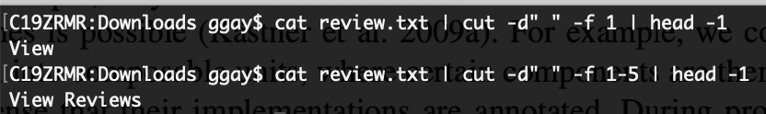
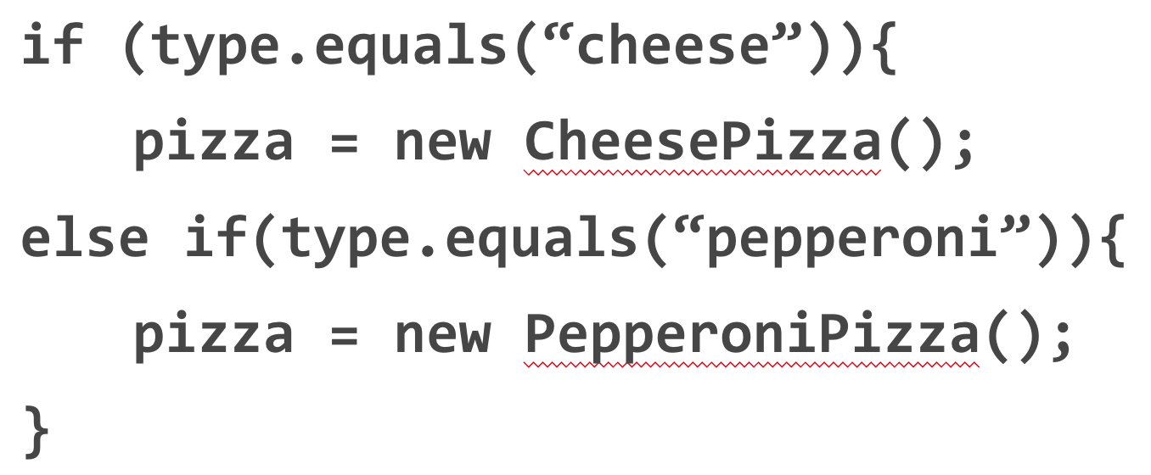
Binding Time
Compile-time Binding
Decisions made when we compile.
#IFDEF preprocessor in C/C++.
Load-time Binding
Decisions made when program starts.
Configuration file or command-line flags.
Run-time Binding
Decisions made while program runs.
Method or API call.
Notes:
When we derive a product, we make decisions; we decide which features will be included in the product or not. We say that we bind a decision. Different implementation techniques allow binding decisions at different times. We can distinguish between compile-time binding (also called static binding or static variability), load-time binding, and run-time binding (also called dynamic binding or dynamic variability). With an implementation technique that supports compile-time binding, developers make decisions of which features to include at or before compile time, when we invoke the compiler. Code of deselected features is then not even compiled into the product, giving us this lean executable.We’ve seen examples a couple of times with IFDEF in C and C++, where we use preprocessors - notes left in the code - that determin what to compile. With an implementation technique that enables load-time binding, developers can defer feature selection until the program is actually started. That is, during compilation all variations are still available; they are decided after deployment, for example, through command-line parameters or configuration files. Some techniques support run-time binding, where decisions are deferred to run time and may even change during program execution ( reconfiguration triggered by external or internal input through method or API parameters). Some implementation mechanisms support mul- tiple binding times.

Slide 30
Binding Time
Compile-time binding improves performance.
… but executable cannot be configured further.
Load-time binding configured at execution.
Run-time binding can be configured any time.
… but results in reduced performance, security hazards, and program complexity.
Notes:
The different binding times each have advantages and disadvantages. Typically, compile-time binding leaves room for more optimizations. All unnecessary code can be removed from the product, reducing run-time overhead in terms of binary footprint, memory consumption, and execution time. However, once the product has been generated and deployed, it is not variable any more—that executable cannot change, and either that customer loses the ability to customize further, or at minimum, you need to compile again. A product with load-time variability is more flexible to reconfigure. Instead of recompiling a new product after each change, end users can modify command line parameters or the configuration file and restart the same executable. A product in which variability decisions are even delayed to run time is able to react immediately, without restart, by adapting its behavior, giving ultimate flexibility. However, mechanisms for load-time and run-time binding often incur a memory and performance overhead, since all variations are compiled into a single executable and consistency conditions must be checked at run time. Including unnecessary functionality in a shipped product may also be considered as potential security threat. It can lead to undesired feature interaction, and requires much more careful testing. So, there is a trade-off to be made.

Slide 31
Technology
Language-based Implementation
Use programming language mechanisms to implement features and derive product.
Pass parameters at run-time.
Tool-based Implementation
Use external tools to derive a product.
Use preprocessor to compile only the requested features.
Notes:
Technology-wisex We have two main routes we can take, classifying different product-line implementation techniques into those that are based on mechanisms provided by a programming language, called language-based approaches, and those that are based on tools that operate on software artifacts to derive products, called tool-based approaches. A language-based approach uses the mechanisms provided by a host programming language to implement features and to derive products. A tool-based approach uses one or more external tools to implement or repre- sent features in code and to control the product-derivation process. A classic language-based approach is to implement variability with run-time parameters. A classic tool-based approach is to use a preprocessor that transforms software artifacts based on a given feature selection. You cannot always draw a sharp line between language-based and tool-based approaches, but this rough distinction is enough to structure our discussion.

Slide 32
Technology
Language-Based Implementation
Feature implementation and management in code.
Easy to understand.
Feature management/boundaries easily vanishes.
Tool-Based Implementation
Separation between implementation and management.
Can simplify code.
Must reason about multiple artifacts.
Notes:
In a language-based approach, both the implementation of features as well as the feature and variability management are located in the source code. This makes it easy for developers and analysis tools to understand and reason about the product line and its implementation as a whole. However, depending on the implementation approach, feature boundaries and feature management tend to vanish in the code, for example, when using run-time parameters to control feature-specific behavior. A tool-based approach favors a clear separation between feature implementation, on the one hand, and feature and variability management and product derivation, on the other. While this separation can simplify the code structure, it makes it necessary for developers and tools to locate, understand, and reason about multiple artifacts in different places

Slide 33
Annotation-Based Representation
All code in common code base.
Code related to a feature marked in some form.
Preprocessor annotations, if-statement that checks input.
Code belonging to deselected features ignored (run-time) or removed (compile-time).
Adds complexity, reduces modularity/readability.
Notes:
A major goal of product line engineering is to derive a product automatically from variable code, based on a user’s feature selection. So, product derivation involves product generation, statically or dynamically. There are two main ways to represent variability and variation points, and how products can be generated: annotation-based and composition-based approaches. In annotation-based approaches, the code of all features is merged in a single code base, and annotations mark which code belongs to which feature. In some sense, an annotation maps a program element to the feature or feature combination it belongs to. A standard example is implementing variable code using the C preprocessor, those IFDEF examples. The C or C++ code comprises the code of all products, and preprocessor directives within the C code control which code fragments are included or excluded upon a feature selection (by setting preprocessor constants). Also the use of parameters that control and alter the behavior of a program at run time can be viewed as a form of annotation too . In this case, an if statement that executes code depending on the feature selection plays the role of an annotation. During product derivation, all code that belongs to deselected features or invalid feature combinations is removed (at compile time) or ignored (at run time) to form the final product. Annotation-based approaches are widely used in practice because they are easy to use and already natively supported by many programming environments. These are what we are going to focus on mainly when we talk about implementation. However,, preprocessor-based and parameter-based implementations are also criticized for their potential complexity, lack of modularity, and reduced readability compared to proposed composition-based approaches.

Slide 34
Composition-based Representation
Code belonging to feature in dedicated location.
Class, file, package, service
Selected units combined to form final product.
Requires clear mapping between features and units
Can combine annotation and composition.
Annotation-based approaches remove code.
Composition-based approaches add code.
Notes:
Composition-based approaches locate code belonging to a feature or feature com- bination in a unit of some kind - a dedicated file, pacakge, class, service, or module. During product deriva- tion, all units of all selected features and valid feature combinations are com- posed to form the final product. A classic example is a framework that can be extended with plug-ins, ideally one plug-in per feature; different products can be generated by integrating different plug-ins. The key challenge of composition-based approaches is to keep the mapping between features (problem space) and composition units (solution space) simple, ideally one-to-one. If each feature has its own imple- mentation in the form of a composition unit, a generator can simply include the corresponding unit in the composition when a feature is selected. In principle, a combination of annotation-based and composition-based approaches is possible and some blending is normal. For example, we could decompose a system into composable units, where certain components are themselves variable in the sense that their implementations are annotated. During product derivation, a generator would select a subset of composition units and remove annotated code from them that belongs to deselected features. Another way to view the difference between annotation and composition is that annotation-based approaches support negative variability (code is removed on demand), and composition-based approaches support positive variability (compo- sition units are added on demand).

Slide 35
Some Examples
Preprocessors
Compile-time, tool-based, annotation-based
Parameters
Load or run-time, language-based, annotation-based
Design Patterns
Load or run-time, language-based, composition-based
Notes:
We will discuss different approaches to implementing variability, but three core examples are preprocessor-based implementation, parameters, and design patterns. (go over)

Slide 36
Preprocessor-Based Implementation
Notes:
Just start with a question - want you to start thinking about this. (read)
This isn’t something with one answer, or even a right answer. It’s something we’ll keep returning to

Slide 37
Preprocessors
Optimize code before compilation.
Often used by compilers to produce faster executable.
Can selectively include or exclude code.
Most famous - cpp
“The C Preprocessor”
Exist for many languages.
Notes:
A preprocessor is a tool that manipulates source code before compilation, with the intent of optimizing the final executable in some form - whether for speed or, in our case, to configure that executable for a particular use. A popular preprocessor is the C preprocessor cpp, which is used in almost every C and C++ project. Most of the examples we’ve seen of this are using cpp so far. cpp provides directives to inline files, to define macros, and to remove code frag- ments based on user-defined conditions. In addition to cpp, many other preprocessors exist, we will talk about Antenna in Java. Important in product line or variable systems development, preprocessors typically provide facilities for conditional compilation, where marked code fragments in the source code are conditionally removed before compilation— #ifdef and #endif in cpp (go over example a little). Conditional compilation is probably the most common mechanism for implementing variability in product lines in industrial practice. This is the prototypical example of tool-based, compile-time, annotation-based variability implementation.

Slide 38
Implementation with cpp
#include enables import from another file.
#include <string.h>
#define used to substitute value for reference.
Reserve one per feature.
#define FEATURE_NAME TRUE
(if the feature is selected, don’t use #define if not selected)
#ifdef/#endif used to conditionally include code.
#ifdef FEATURE_NAME
Notes:
cpp, which is mainly used for c and c++, provides facilities for file inclusion, lexical macros, and conditional compilation. Together, these enable the implementation of variability. If you have developed in c or c++, yoiu’ve seen the use of the #include directive as a way to import functionality from another source. At #include directives, the preprocessor lexically inlines files, for example, to bring in code from header files. macros are defined with #define directives. After defining a macro, the preprocessor replaces all occurrences of a corresponding token by another token sequence. Macros serve as compile-time variables and functions; they can be defined, redefined, and undefined while preprocessing a file. To implement software product lines, we reserve a name per feature (typically F as the name of the feature), and define the macro (using “#define F”) only when the feature is selected. Finally, conditional compilation, with #if, #ifdef, and similar directives can suppress token sequences so that they are not compiled. The #if directives evaluate compile-time expressions, typically checking whether macros are defined or not. So, we define a feature if we are using it, then, the ifdef check sees that that feature has a defined macro, it evaluates to true, and that code is included. For other features that we do not select, that code is ignored because we haven’t set a macro to true for that feature.

Slide 39
Implementation with cpp
#ifdef
#if defined(MACRO)
Check if a macro is defined. If true, code is included.
Define macro for included features.
#if (...) can check a user-defined condition.
Notes:
Here, we have two examples. You’ve seen the one on the left before, but to really drill it home. Three features - NAME, NONAME, COLOR. Check if these are defined using either #ifdef or #if defined. #if can also check any user-defined condition, but we generally keep this simple and just define a macro for any used feature and skip this for features not included (go over code a little)

Slide 40
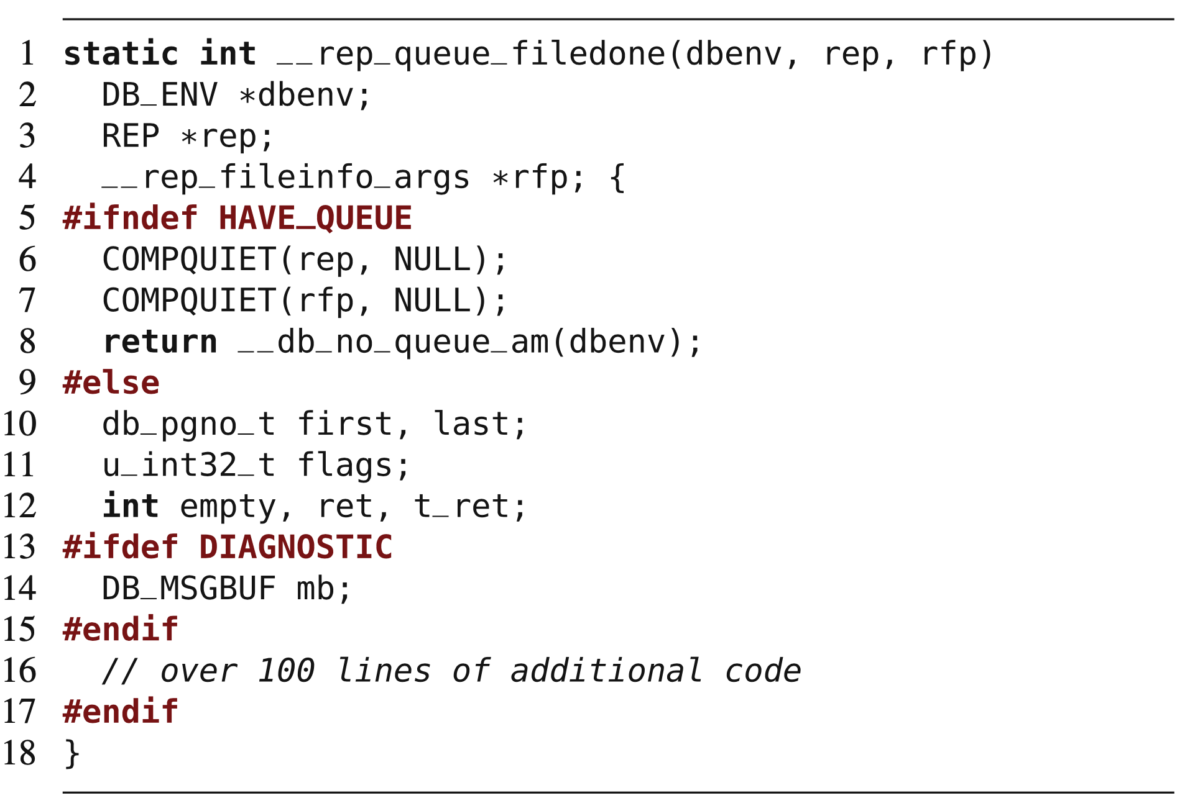
Implementation with cpp
#ifndef
“if not defined”
#else
Note nesting of directives.
Line 17 ends line 5 directive.
Notes:
Here is another example, from a database implementation. In addition to the common #ifdef and #endif directives, we can see negation (#ifndef), alternatives (#else), and nesting of preprocessor directives. The example illustrates also the common case of long annotated code fragments, here annotating over 100 lines of code (see comment in Line 16). The preprocessor removes code according to macro definitions before compilation. (go over a little)

Slide 41
Let’s take a break!
Notes:
Just start with a question - want you to start thinking about this. (read)
This isn’t something with one answer, or even a right answer. It’s something we’ll keep returning to

Slide 42
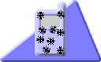
Implementation with Antenna (Java)
Similar to cpp
Annotations written as comments.
Comments out code that is not selected and uncomments code that is selected.
Available from http://antenna.sourceforge.net/
Part of FeatureIDE or can used from command line.
Notes:
cpp has been the standard way to compile C and C++ code for some time now, so this capability is innate to C or C++ development. You are unlikely to write in either language and NOT have the ability to implement variability in this manner. However, natively, Java has limited facilities for conditional compilation. So, we turn to external tools that enable this option. One of the more common is Antenna. Antenna is a preprocessor origianlly developed for Java Mobile Edition projects, which usually target embedded devices with limited resources and varying capabilities. Antenna is unusual as it integrates into existing development processes and code editors for Java. It mimics the syntax of the C preprocessor, but, preprocessor directives are written in comments not to interfere with existing code editors. Instead of removing code fragments, Antenna comments out code fragments annotated with deselected features and uncomments code fragments of selected features. This way, developers can edit Java code in their normal code editors and quickly switch between alternative feature selections; code is changed in-place and not generated in separate files. Antenna is implemented in FeatureIDE or can be used from the command line

Slide 43
Implementation with Antenna (Java)
Annotate code using comments:
//#if FEATURE_NAME
If FEATURE_NAME is chosen, include this code.
//#elif OTHER_FEATURE
else if OTHER_FEATURE chosen, include this code.
//#else
//#endif
Instead of removing lines, Antenna comments out lines, inserting //@
Notes:
Antenna uses the following directives to annotate optional code: #if expression, #elif expression, #else, and #endif (explain each). Additionally, a whole file can be annotated at once using the directive #condition expression in the first line of the file. Instead of a removal of the specific lines, Antenna uses //@ comments for the deactivation of code. Therefore, it is also possible for Antenna to use the same files as input and output to cleanly transform code.

Slide 44
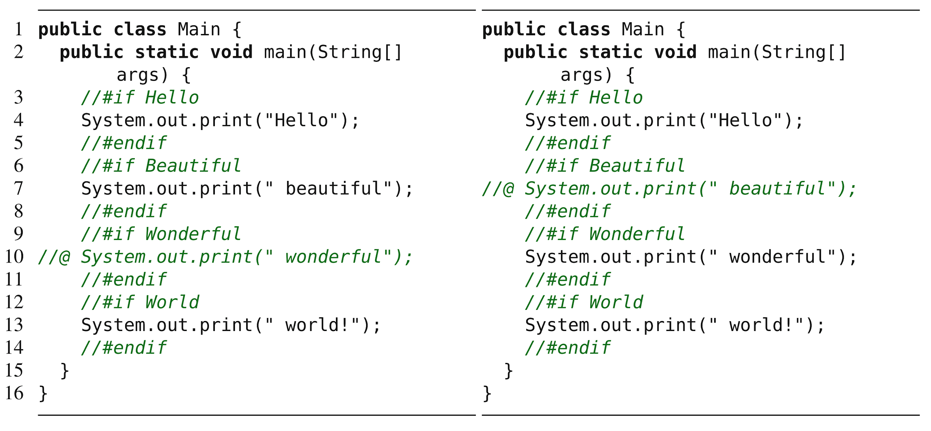
Examples
(Hello, Beautiful, World) (Hello, Wonderful, World)
Notes:
Left - we chose features Hello beautiful world, right hello wonderful world - point out annotations and commented code

Slide 45
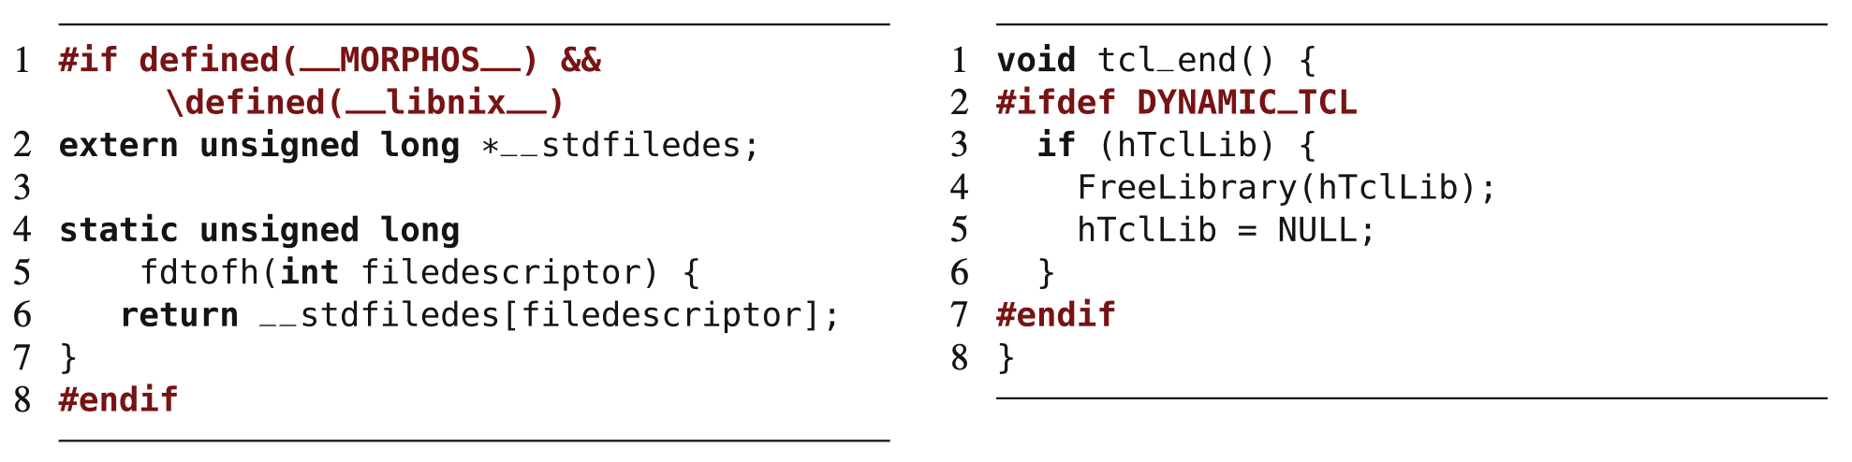
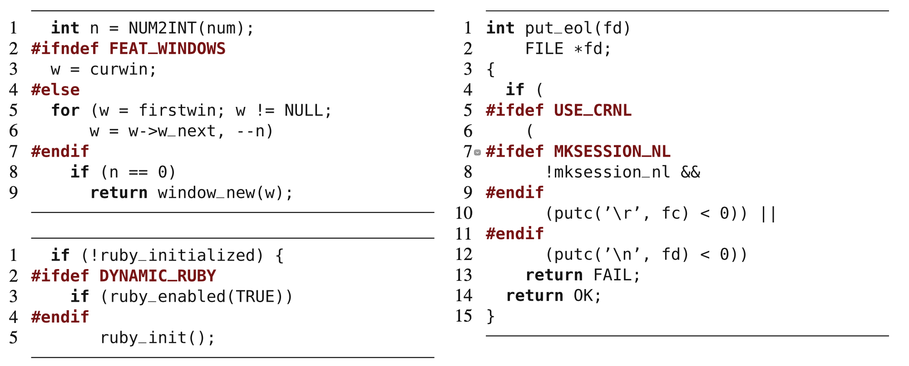
Proper Use of Preprocessors
Should wrap around an entire function, declaration, or expression.
Bad annotations wrap partial expressions.
Notes:
Preprocessors are powerful tools that allow almost arbitrary source-code manip- ulation at compile time. The power comes at the price of writing complex and hard-to-maintain and hard-to-understand source code. Similar to the goto statement, preprocessors have at times earned a poor reputation. Preprocessor annotations can align with the underlying structure but do not have to: Developers can use conditional compilation to annotate entire syntactic blocks of source, such as entire functions or entire statements, or they can wrap parts of statements or partial functions. Disciplined annotations - annotations used properly - align with the syntactic structure of the source code. Disciplined annotations can be mapped to elements of the code’s abstract syntax tree and are restricted to selected structures, typically, top-level declarations, fields, and statements, but not subexpressions or parameter declarations. On this slide, we have a number of code fragments from the source code of the text editor vim. The examples on the top are proper - they wrap around a top level declaration on the left and entire statement on the right. The ones on the bottom are not - they wrap around substatements and eubexpressions. Notice how the annotation in the first example on the bottom changes the structure and decides whether Line 8 is in the body of a for loop or not. This can result in nightmare code, where the end result is not what you exptected or wanted, and this could be a subtle failure that you miss until it causes a major issue. The notion of disciplined annotations can help developers avoid complex implementations that might be hard to maintain and are usually also easier to read and maintain.

Slide 46
Benefits of Preprocessors
Easy to learn (annotate and remove code).
Can be applied to code and other artifacts.
Allow changes at any level of granularity.
Easy to map features and code.
Can be added to a non-product line to transform it into one over time.
Notes:
On the positive side, preprocessors are lightweight and easy-to-use tools for compile- time variability that are already available in many language environments. They have a simple programming model: Annotate and conditionally remove code. Most developers, especially C developers, are familiar with them; otherwise, they are easy to learn. In environments without preprocessors, they can be added as lightweight tools, like with antenna in Java. Developers can apply lexical preprocessors such as the C preprocessor uniformly to artifacts of different kinds, even noncode and nontext artifacts. Thus, the same variability mechanism can be used for source code, grammars, models, documentation, and so forth. They allow changes at arbitrary levels of granularity, not confined by mechanisms of the host language. Fine- grained compile-time variability allows controlling precisely what code is actually deployed, even at statement level. Even disciplined annotations scale to many levels of granularity. Since most preprocessors are rather simple, it is usually easy to extract feature to code traceability information. Annotations can refer directly to features. Although feature code may not be localized in one file, a simple search or an analysis tool can statically determine the code locations affected by a feature. Finally, granularity, expressiveness, and their lightweight nature render preproces- sors well-suited for extractive product line adoption . It is easy to add a few preprocessor directives to existing code, to make code fragments optional or encode alternative. This lightweight, easy-to-learn, and easy-to-adopt nature is what makes them so popular in practice.

Slide 47
Drawbacks of Preprocessors
Feature code scattered across codebase and mixed with other features.
Encourage developers to patch and add to code instead of refactoring.
Can make it hard to understand control flow in code
Can introduce errors, especially when used on partial statements.
Notes:
Preprocessors are criticized for multiple reasons too. Feature code is scattered across the code base and tangled with code of other features. There is no support of encapsulation of features separate from other features. Even when feature code is roughly separated into distinct files, scattered annotations remain to inject the feature code into the base code. Scattering not only affects source code, but configuration knowledge as well. Configuration parameters can be defined, redefined, or undefined within the source code. Such scattering of configuration knowledge can make it hard to understand when or why a certain code fragment is included in a product. Preprocessors, due to their simplicity, invite developers to make ad hoc extensions and use “quick and dirty” solutions, instead of restructuring and refactoring the code. Features can be steadily added in a patch-by-patch fashion, but may never be removed or reflected in the design. Such ad hoc use can lead to implementations that are hard to understand and maintain. Furthermore, preprocessors are criticized for obfuscating source. Annotations are typically not part of the language, but added on top by an external tool, multiple languages are intermixed in the same file. Especially, when annotations are applied at a fine grain, are strongly scattered, or are used in undisciplined ways, it can be difficult to follow the control flow in the host language. The term “#ifdef hell” reflects this problem. The degree of source-code obfuscation depends on how the preprocessor is used. A small number of disciplined annotations is often perceived as acceptable. However, if applied in an ad hoc fashion, fine- grained annotations and a large number of annotations can quickly reduce readability. Preprocessors are also considered to be error prone. Most preprocessors lack proper diagnostic tools. Using annotations to implement optional features can easily introduce errors that can be difficult to detect. If used in an improper fashion on partial statements, even simple syntax errors, such as not closing a corresponding bracket in some feature selections can sneak in undetected. There is no way to check features in isolation, as one might attempt for modular implementations, such as plug-ins or components.
Overall, preprocessors are a simple means to implement variability, but one with several dangerous pitfalls.If used sparely in a disciplined fash- ion, and if possible with suitable tool support,, many problems can be avoided.

Slide 48
Parameter-Based Implementation
Notes:
Just start with a question - want you to start thinking about this. (read)
This isn’t something with one answer, or even a right answer. It’s something we’ll keep returning to

Slide 49
Language-Based Variability
Programming languages offer means to implement variability in different ways.
if-statement offers a choice between two options.
Common approaches:
Parameters
Design Patterns
Frameworks
Components and Services
Notes:
There are many ways to implement variable code using the mechanisms of a programming language; some have been used long before the invention of software product lines. Even a simple if statement offers a choice between different execution paths. To prevent cluttering of code with if statements, to enhance feature traceability, to provide extensibility without the need to change the original source code, and to provide compile-time (or load-time) variability, developers have identified many common programming patterns to support variability, including parameters, designs patterns, frameworks, and components and services. Today, we will discuss parameters, next class we will talk about design patterns, than frameworks and components will be discussed in the class after that. These language mechanisms are well-known and commonly used in practice. Most industrial software product lines are implemented with one or more of them, working in combination to enable controlled variability. As we will see, each has benefits and downfalls

Slide 50
Parameter-based Implementation
Use conditional statements to alter control flow based on features selected.
Boolean variable based on feature, set globally or passed directly to methods:
From command line or config file (load-time binding)
From GUI or API (run-time binding)
Hard-coded in program (compile-time binding)
Notes:
We can start to talk about implementing variability in the code with the simplest method, and work our way up to more complex methods. A simple way to implement variability is to use conditional statements (such as if and switch) to alter the control flow of a program at run time based on the selections made for each variation point. In our context, conditional statements are typically controlled by configuration parameters passed to a method or a module, or set as global variables in a system. Different parameter assignments lead to different verisons - different configurations of a program when it is executed. There are many ways to set configuration parameters. In general, we expect one Boolean parameter per feature, either set globally or at an appropriate level of scoping. These variables should, ideally, be named in a way that directly maps to the feature model. Often, command-line para- meters (such as in “ssh -v”) or configuration files (such as system.ini or httpd.conf) are read at startup and stored in global variables. This is an example of load-time binding - we make choices when the program is executed, by passing in our choices from the command-line or using this configuration files. In other cases, users can change parameters in a GUI using preference dialog boxes or as part of an API request - such as a POST request to a REST api, sometimes with immediate effects - run-time binding - or at other times requiring a restart - load-time. In a third, rarer case, values of variables can also be hard-wired in source code, so changing them requires recompilation - AKA a compile-time binding. So, the use of parameters is a flexible approach, simply noting in the code how to make use of these parameter settings.

Slide 51
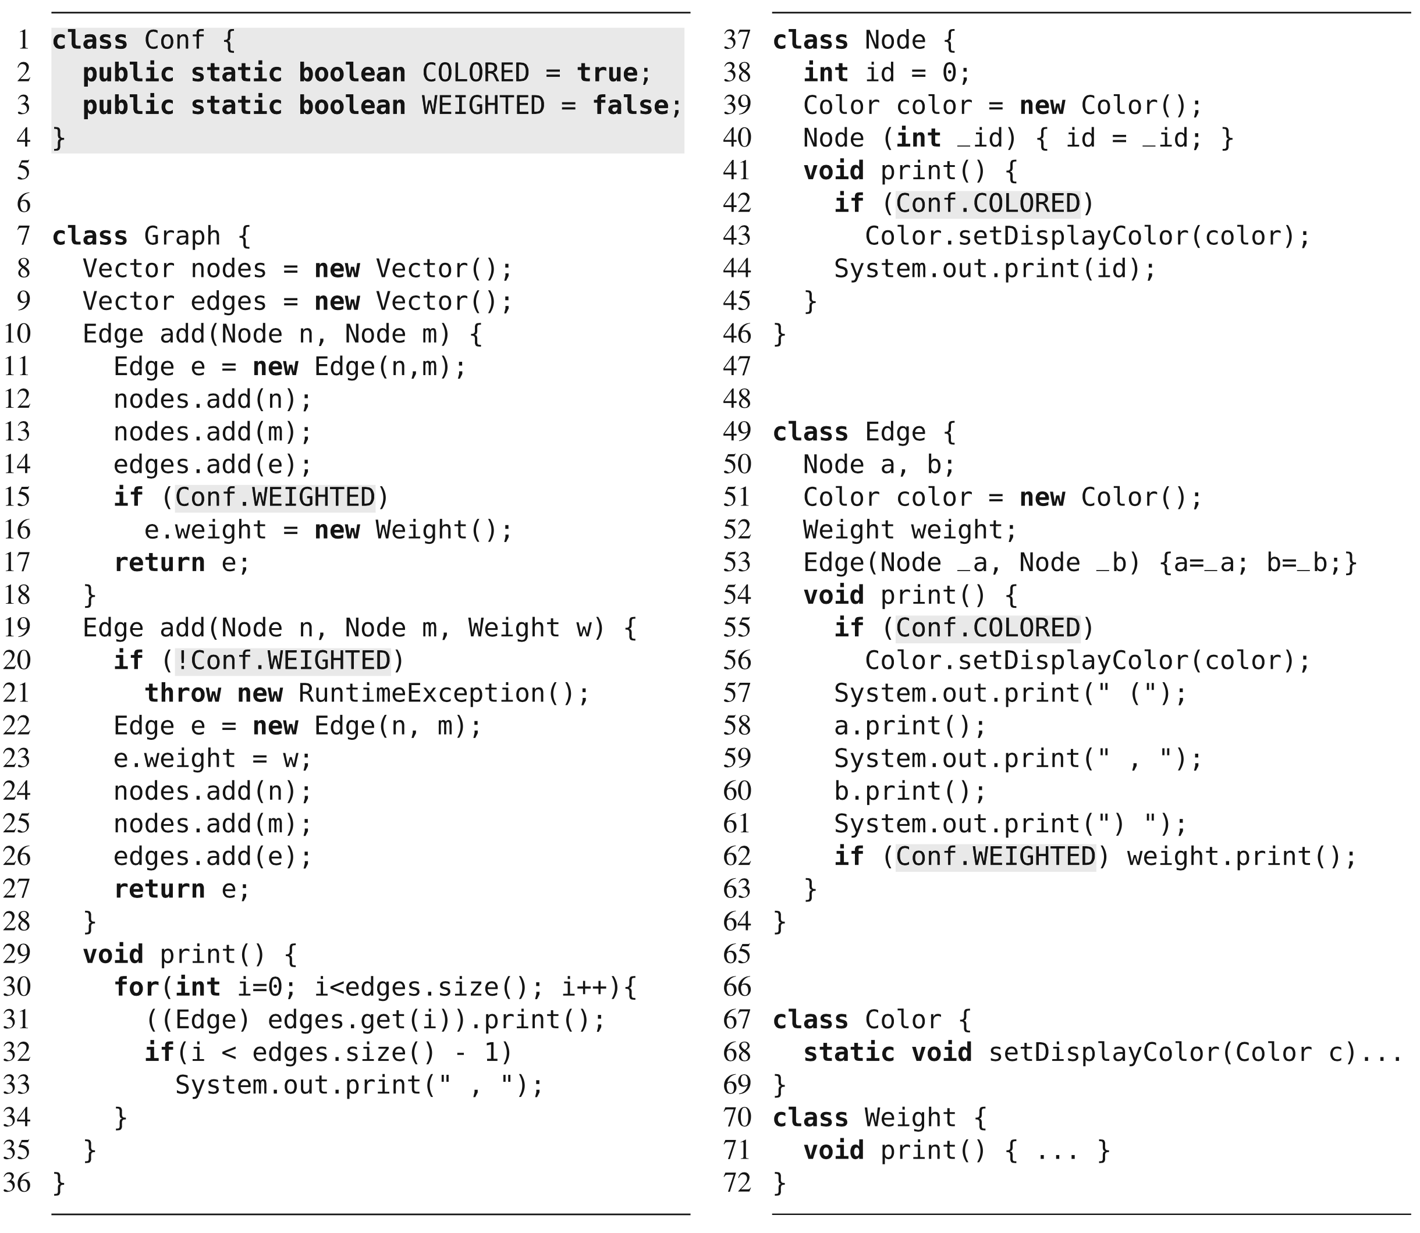
Choices read from command line and stored in Conf.
Other classes check variables and invoke code appropriately.
Notes:
This is pretty simple, and has its benefits and drawbacks. we show our graph example with two configurable features, Weighted and Colored, implemented as global configuration parameters. Class Conf stores two parameters, possibly initialized during startup from command-line parameters or from configuration files. W read in the choices from the user at load time, store the values in these parameters. These parameters are evaluated inside if statements in the classes Graph, Node, and Edge to trigger feature-specific behavior on demand.

Slide 52
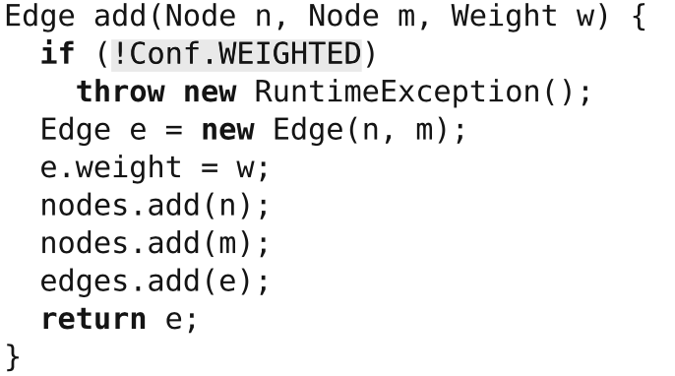
Discussion
Variation is evaluated at run-time.
All functionality is included, even if never used.
More memory required.
If-statements add computational overhead.
Security risks introduced, i.e., buffer overflow attacks.
Notes:
Implementing variability with parameters is straightforward. For this reason, it is widely used in practice. Variation is evaluated at run time when conditional statements are executed. The parameter approach shares the usual benefits and drawbacks of run-time binding. For example, all functionality is included in all deployed products, even if it is known that a feature will never be selected. This has potentially negative implications for resource consumption, performance, and security: First, deactivated function- ality is still delivered. Second, performing run-time checks requires additional computing overhead. In our example on the last slide, even though we know that we never use feature Colored, the application still contains class Color, evaluates an additional if statement whenever a method print is called, and requires memory for an additional field of every node and edge object. Third, we cannot prevent others from instantiating objects or invoking methods of deactivated feature code, other than throwing run-time errors. Finally, shipping unused code opens unnecessary potential targets for attacks, such as buffer-overflow attacks.

Slide 53
Discussion
Can alter feature selection at run-time.
However, code may depend on initialization steps.
May be easier to restart.
Can pass to methods instead of setting globally.
Allows different configurations throughout program.
Notes:
It is possible to alter a feature selection without stopping the program. However, run-time changes are nontrivial in general, as a feature’s code may depend on certain initialization steps or assume certain facts are true. For example, we might run into a null-pointer exception, if we enabled Weight at run time, because the field weight of previously created edges was uninitialized. In such cases, it might be easier to require a restart of the program, when configuration parameters change.
In addition, An advantage of passing configuration parameters as method arguments (in contrast to using global variables or using compile-time variability) is that different parts of the control flow can be configured differently. For example, we could use colored graphs and uncolored graphs in the same program.

Slide 54
Discussion
Conditional statements are a form of annotation.
Mark boundaries between features.
Global variables reduce independence of modules.
However, passing many arguments reduces understandability/requires repetition.
Pass a “configuration object” containing settings.
Feature code mixed and scattered across project.
Hard to understand and change.
Notes:
Adding conditional statements to the source code is a form of annotation - we mark our intentions, the boundaries between features, within the code. Annotations with conditional statements are available at a fine granularity. With if statements, we can change the program behavior at statement level. Configuration parameters can be encoded in essentially all programming languages; however, they are usually not applicable to noncode artifacts, such as, design documents, grammars, and documentation.
Configuration parameters can lead to implementations that have a poor code quality. On the one hand, global parameters are tempting but reduce modularity (the ability to break the code into independent modules). On the other hand, propagating method arguments requires boilerplate code and may lead to methods with many parameters. A typical recommendation is to pass a single configuration object around that encapsulates multiple configuration options, known as parameter objects.
Finally, with the parameter approach, variability-related code crosscuts the remaining implementation. Feature code is scattered across multiple files and modules, in variables, in method arguments, in if statements, and so forth. Furthermore, feature code is tangled with the base code and code of other features. it is difficult to encapsu- late a feature’s code behind an interface and to place all feature code in one cohesive structure. Due to the scattering and lack of cohesion, it can be nontrivial to trace a feature to all code fragments implement- ing it: one has to follow the control flow, possible assignments to other variables, and possible operations on the configuration parameters. The parameter approach can lead to undisciplined ad-hoc implementations that are difficult to analyze, maintain, and debug. It is generally preferred to use other approaches, which we will go into in the next classes.

Slide 55
Benefits and Drawbacks
Benefits
Easy to understand and use.
Flexible
Allows different configurations in same program.
Drawbacks
All code in executable.
Feature code and configuration knowledge scattered across program.
Difficult to link feature model and implementation.
Notes:
To summarize

Slide 56
We Have Learned
How do we build a custom product from a feature selection?
Binding Time
Compile, load, run-time
Technology
Language vs Tool-Based Implementation
Representation
Annotation vs Composition
Notes:
go over
annotation (mark notes in the code to denote feature boundaries), compositon (feature code is separate and plugged in from a the correct class.

Slide 57
We Have Learned
Preprocessors
Mark code to include in compiled executable.
Omit code that we do not select entirely.
Compile-Time, Tool-Based, Annotation-Based
Parameters
Set Boolean variables via command-line, config file, GUI, API, etc. globally or pass to methods.
Use if-statements to execute correct code.
Load or Run-Time, Language-Based, Annotation-Based

Slide 58
Next Time
Variability implementation using design patterns.
Load or run-time binding, language-based, composition-based.
Assignment 2 - any questions?
Due November 29
Feature modelling and analysis for mobile robots

